Slide 1
System Usability Scale (SUS)
Honeywell Internal

Slide 2

SUS Tool
A simple, ten-item attitude Likert scale giving a global view of subjective assessments of usability
The System Usability Scale (SUS) is a simple, ten-item scale giving a global view of subjective assessments of usability.
It was developed by John Brooke at Digital Equipment Corporation in the UK in 1986 as a tool to be used in usability engineering of electronic office systems.
Maintains it’s relevance today and is still the most used questionnaire for measuring perceptions of usability.
Honeywell Internal

Slide 3
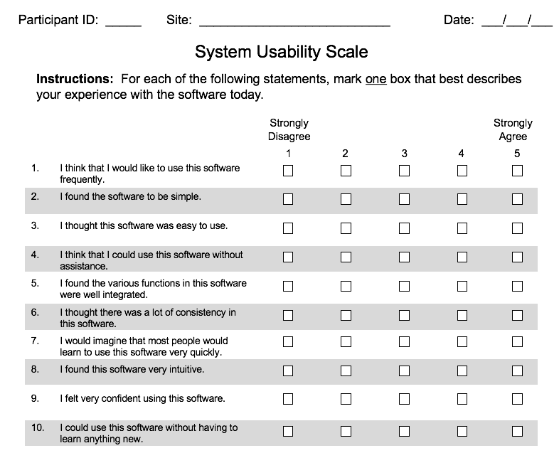
Overview
SUS Tool
It consists of a 10 item questionnaire with five response options for respondents; from Strongly agree to Strongly disagree.
The statements cover a variety of aspects of system usability, such as the need for support, training, and complexity
Honeywell Internal

Slide 4
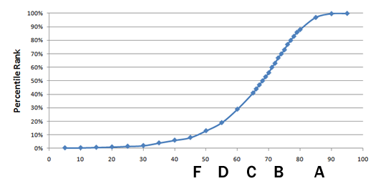
Overview
SUS Tool
The SUS tool is an Excel workbook into which one enters the user rating scores.
The SUS workbook uses the results and calculates a score for the interface ranging from 0-100.
A SUS score above a 68 would be considered above average and anything below 68 is below average
How a SUS score compares to a traditional letter grade.
http://www.measuringusability.com/sus.php
Honeywell Internal
Notes:
If you want to read more you will have the guide.

Slide 5
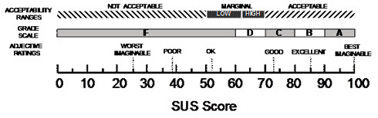
SUS in Practice
The SUS will be done iteratively – once at the beginning of the project to uncover issues with the current experience and once after changes are made to measure impact and improvements.
SUS Score Interpretation
SCORECARD CODING
Red: 0-50
Yellow: 50-67
Green: 68-100
ACCEPTABILITY RANGES
GRADE SCALE (CURVE)
F
D
C
B
A
SUS SCORE
Honeywell Internal

Slide 6
Why SUS?
SUS Tool
Inexpensive means to understand how well an interface is performing based on customer feedback
Quantitative measurement that can help gauge improvements and success
Industry standard for 25 years, and its wide usage has allowed it to be studied and examined
Technology independent and has since been tested on hardware, consumer software, websites, cell-phones, IVRs and even the yellow-pages
But Remember . . .
SUS scores were not meant to be diagnostic. More insight is required via heuristic evaluation to determine what needs to be fixed.
Honeywell Internal

Slide 7




SUS
The UX professional needs to recruit users who are actually using the product and thus can provide real experiential feedback through filling out the SUS.
TIPS FOR RECRUITING:
Try to find people as close to the target user groups as possible
Try not to recruit anyone “too close” to the project
Where possible do not recruit business leaders who will “represent” a user group – test the actual user group
Target number of participants should is 5 – 8 people
Honeywell Internal

Slide 8
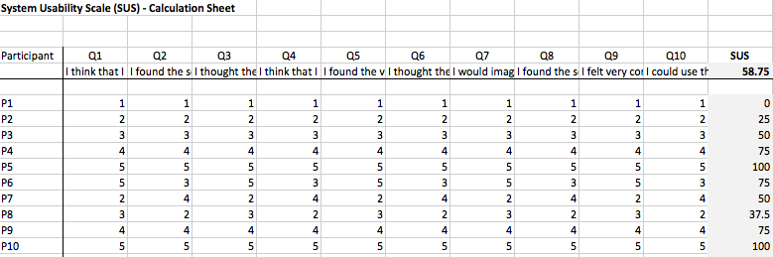
SUS Evaluation Process
The results are then entered into the SUS Calculation workbook and scores automatically calculated.
Honeywell Internal

